Slide 1

Epidemology
Data analysis course 2016-Project n°3
Hannes Imboden, Linus Leo Stöckli, Miloš Ivanovic, Nicola Gadola, Philipp A.Huber

Slide 2
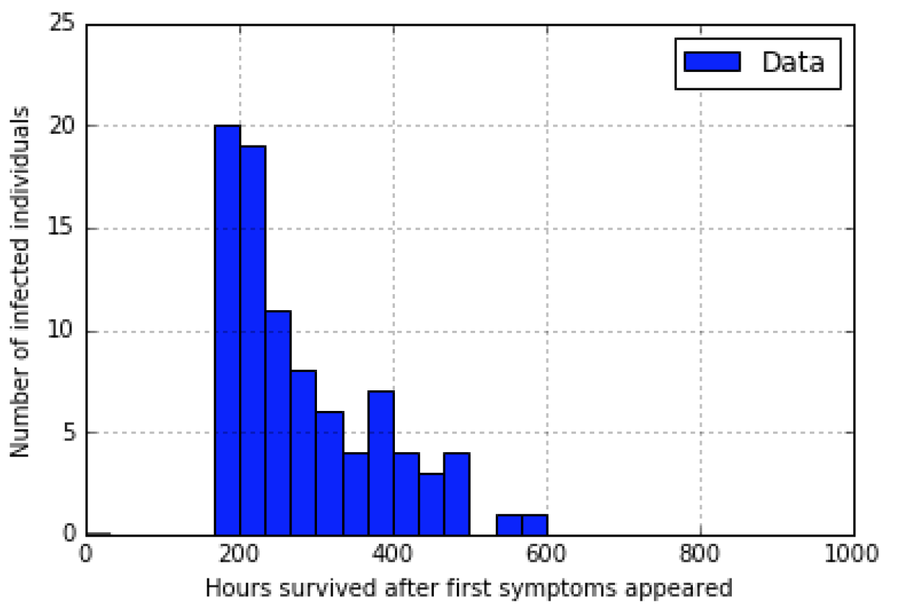
First data set

Slide 3
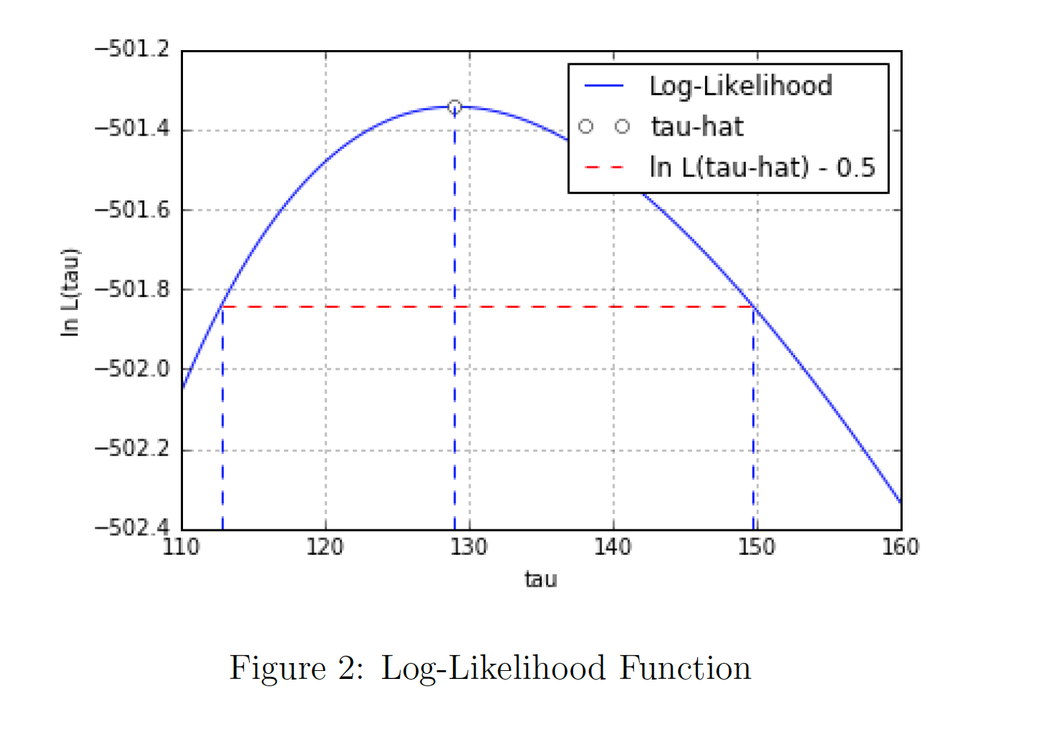
Log-Likelihood function

Slide 4
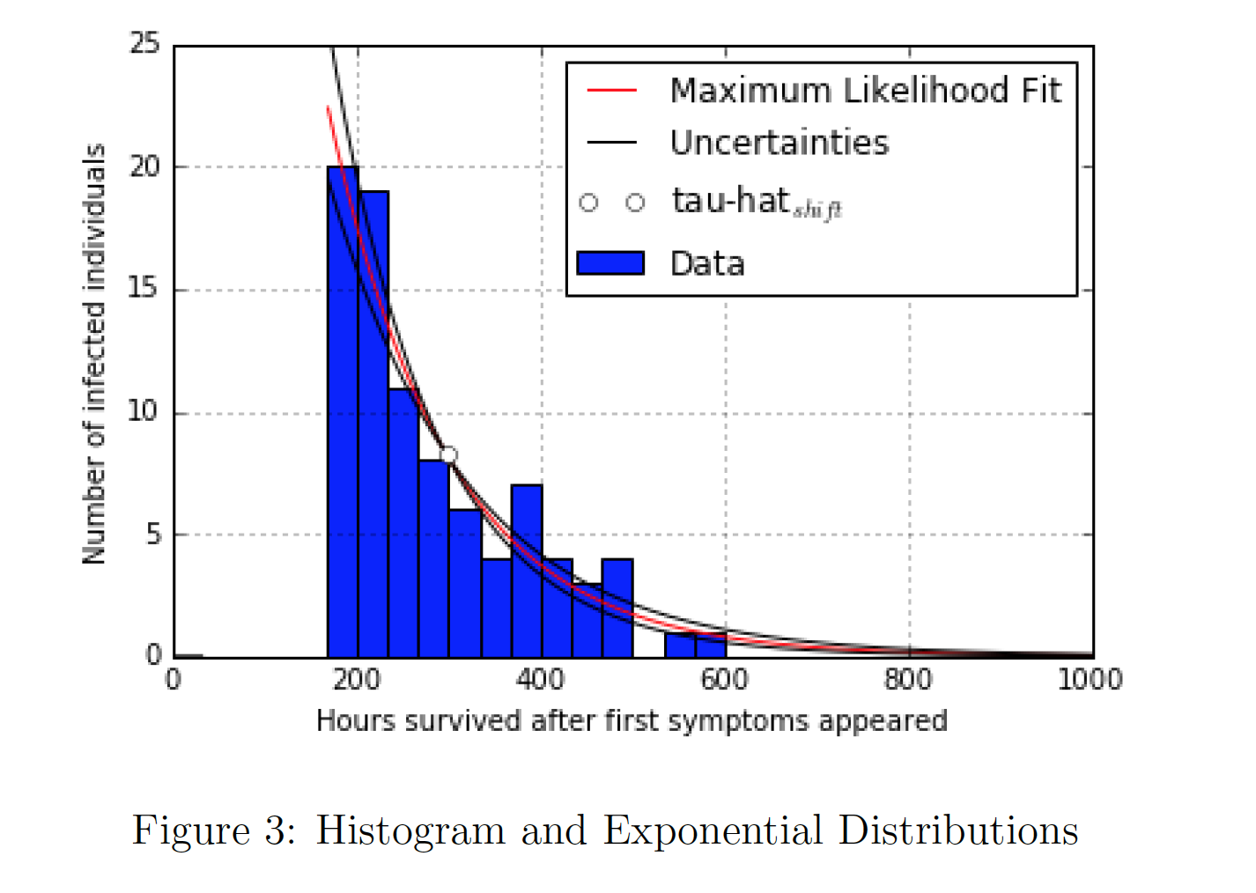
Histogram and exponential distributions

Slide 5
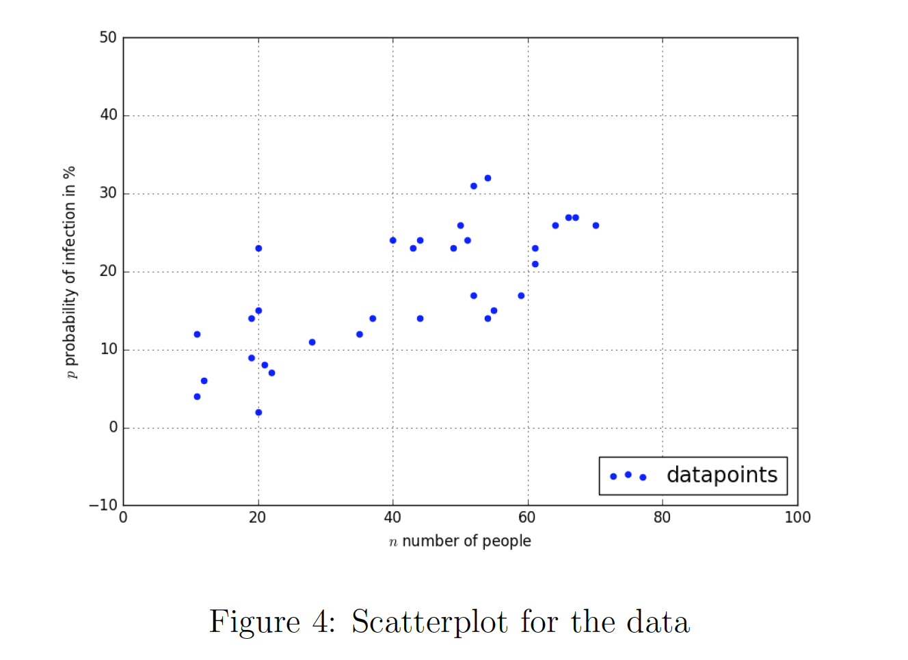
Scatter plot for the data

Slide 6
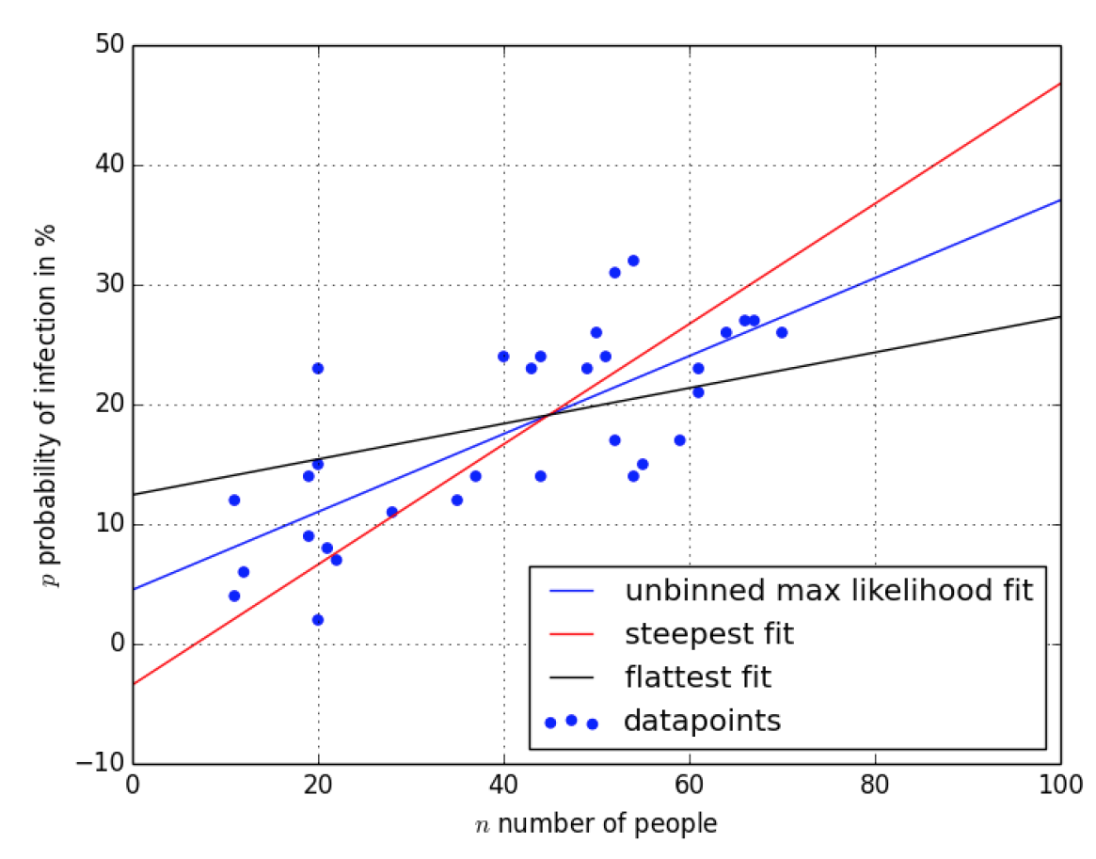
Best fit and errors on the slope

Slide 7
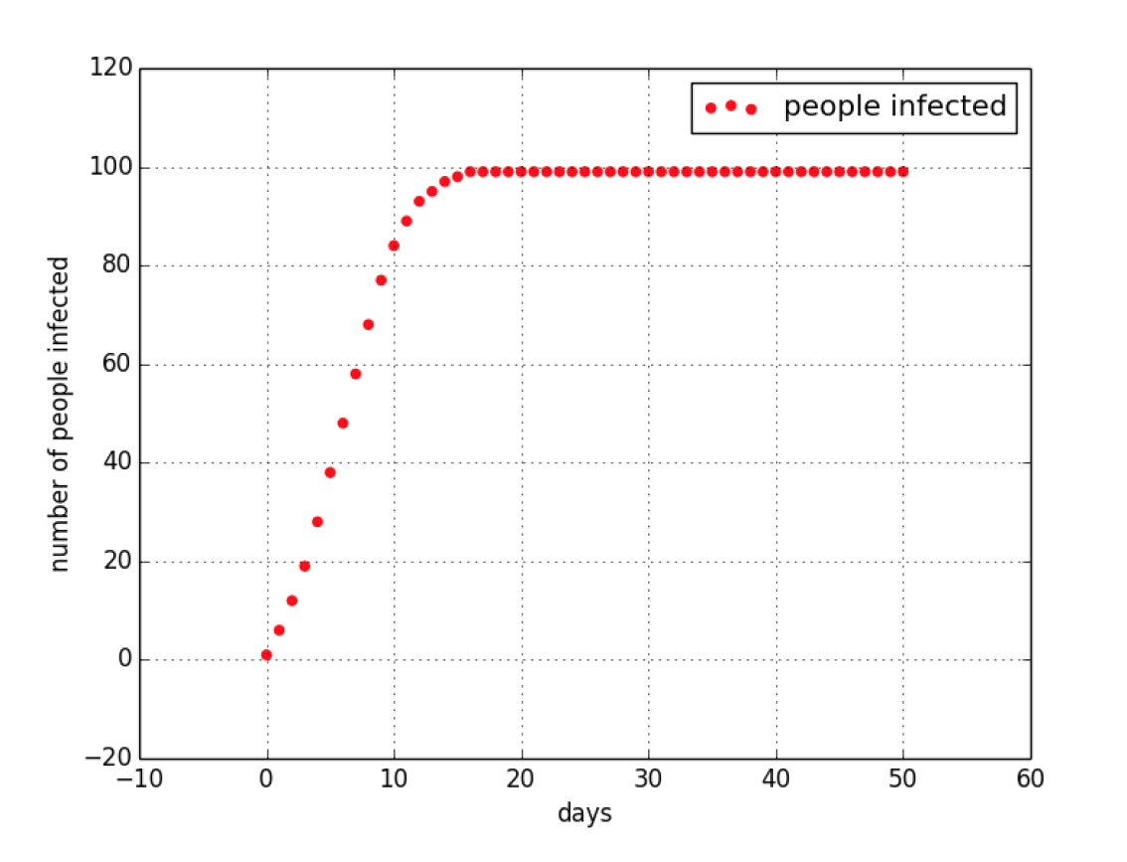
Spread of the disease in the village

Slide 8
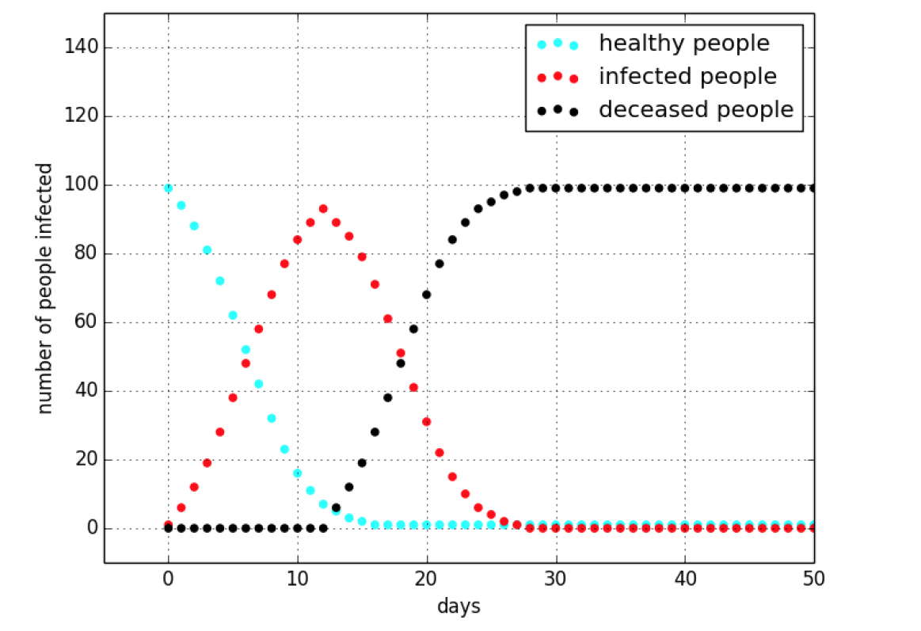
Evolution of the disease in the village

Slide 9
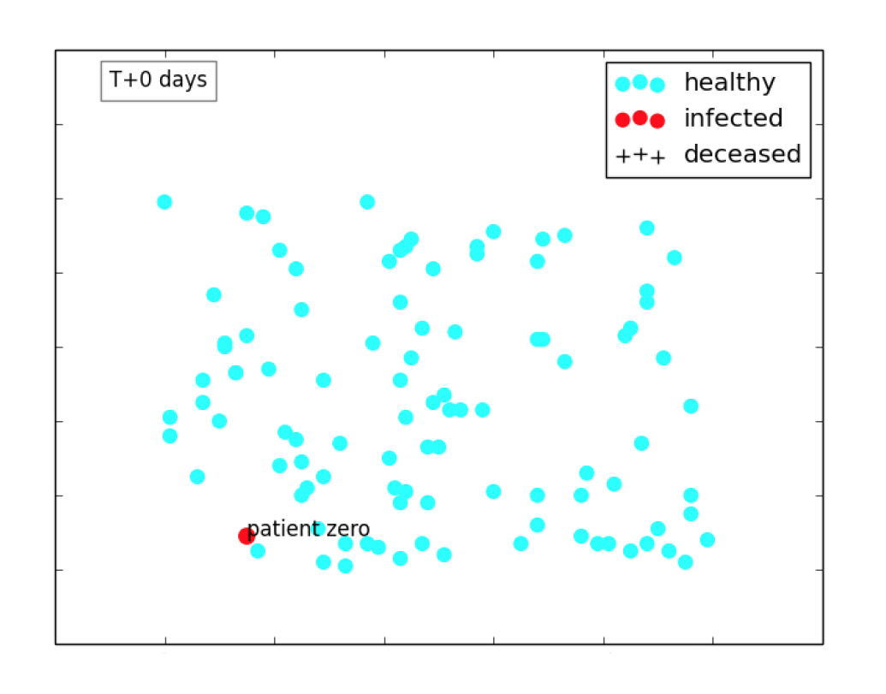
The village on the day the epidemic starts

Slide 10
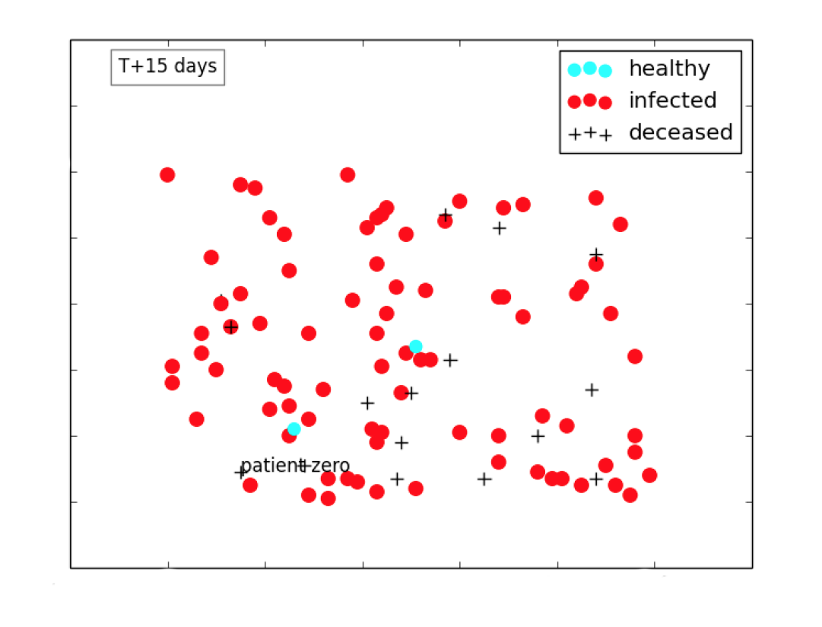
The village on the 15th day

Slide 11
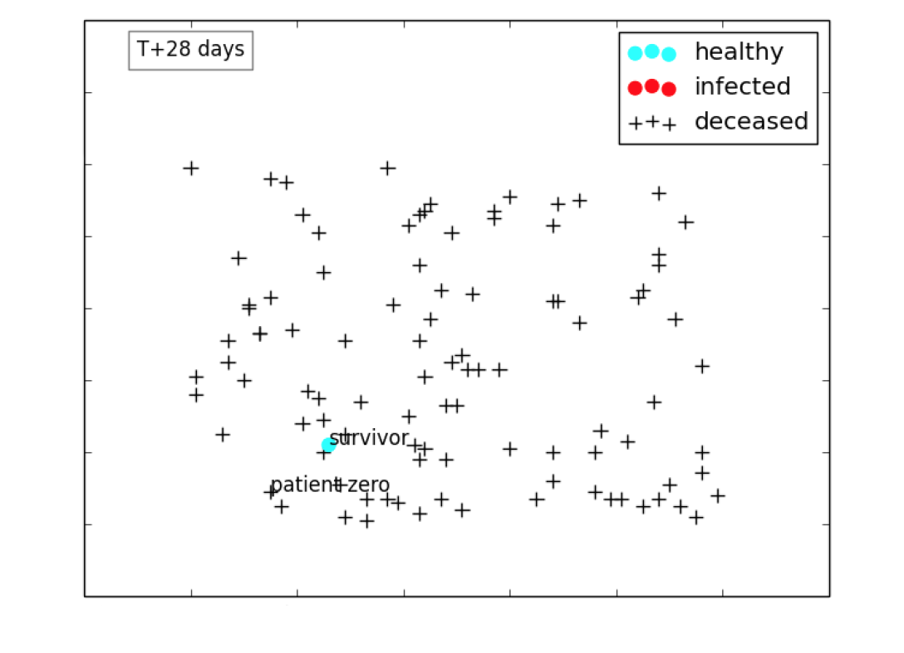
The village on the 28th day

